Slide 1
Chapter 2 – Implementing and securing link redundancy protocols

Slide 2
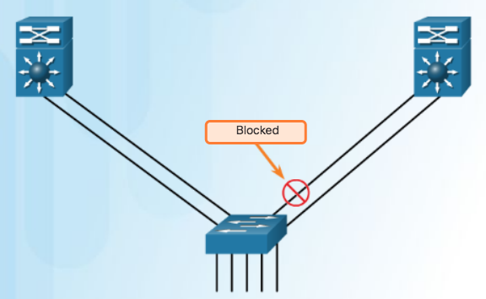
Link Aggregation
Introduction to Link Aggregation
It is possible to combine the number of physical links between switches to increase the overall speed of switch-to-switch communication.
  STP will block redundant links to prevent routing loops.
Redundant Links with STP (by default blocked)
Notes:
4.1 – Link Aggregation Concepts
4.1.1 – Link Aggregation
4.1.1.1 – Introduction to Link Aggregation

Slide 3
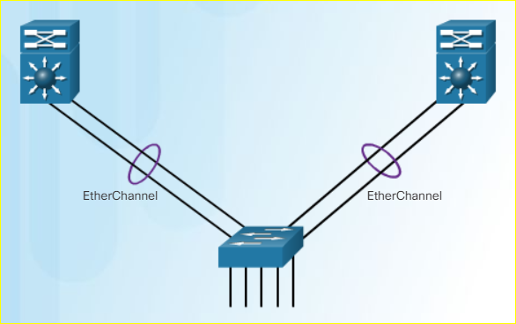
Link Aggregation
Advantages of EtherChannel
Most configuration tasks can be done on the EtherChannel interface instead of on each individual port.
EtherChannel relies on existing switch ports.
Load balancing takes place between links that are part of the same EtherChannel.
EtherChannel creates an aggregation that is seen as one logical link.
EtherChannel provides redundancy because the overall link is seen as one logical connection.
Notes:
4.1 – Link Aggregation Concepts
4.1.1 – Link Aggregation
4.1.1.2 – Advantages of EtherChannel

Slide 4
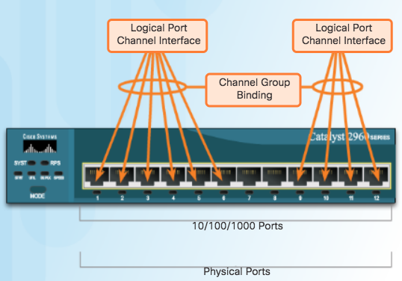
EtherChannel Operation
Implementation Restrictions
EtherChannel groups multiple physical ports into one or more logical EtherChannel links.
EtherChannel Restrictions
  Interface types cannot be mixed. (Fast Ethernet + Gigabit Ethernet cannot be grouped.)
  Provides full-duplex bandwidth up to 800 Mbps (Fast EtherChannel) or 8 Gbps (Gigabit EtherChannel)
  Cisco IOS Switch can support 6 EtherChannels.
  Created between two switches or a server and switch.
  If one side is configured as trunk, the other side must be a trunk within same native VLAN.
  Each EtherChannel has a logical port channel interface and changes to a channel affects its physical interfaces.
Notes:
4.1 – Link Aggregation Concepts
4.1.2 – EtherChannel Operation
4.1.2.1 – Implementation Restrictions

Slide 5
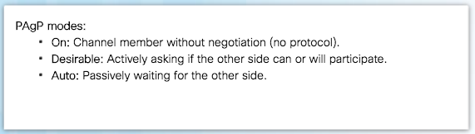
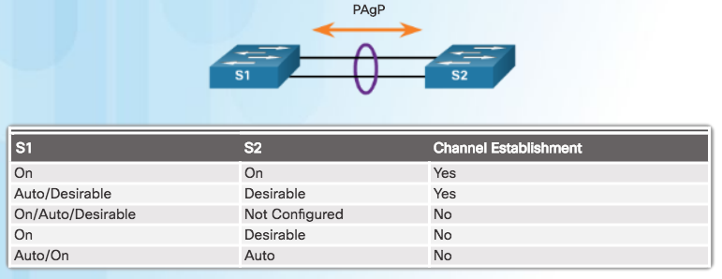
EtherChannel Operation
Port Aggregation Protocol
EtherChannels can be formed by using PAgP or LACP protocol
PAgP (“Pag-P”) Cisco-proprietary protocol
Notes:
4.1 – Link Aggregation Concepts
4.1.2 – EtherChannel Operation
4.1.2.2 – Port Aggregation Protocol

Slide 6
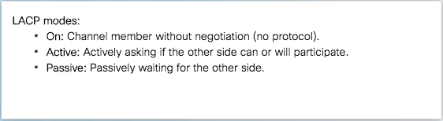
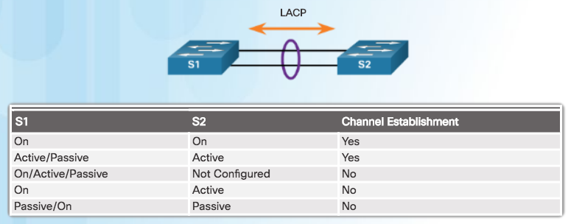
EtherChannel Operation
Link Aggregation Control Protocol
LACP multivendor environment
Notes:
4.1 – Link Aggregation Concepts
4.1.2 – EtherChannel Operation
4.1.2.3 – Link Aggregation Control Protocol

Slide 7
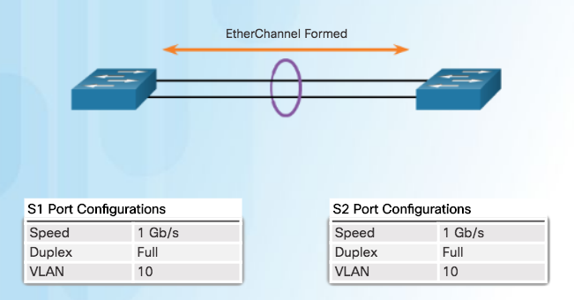
Configuring EtherChannel
Configuration Guidelines
Configuration Settings Match on Both Switches
  Same speed and duplex mode.
  All interfaces in a bundle must be assigned to the same VLAN, or configured as a trunk.
  Trunk must support same range of VLANs.
Notes:
4.2 – Link Aggregation Configuration
4.2.1 – Configuring EtherChannel
4.2.1.1 – Configuration Guidelines

Slide 8
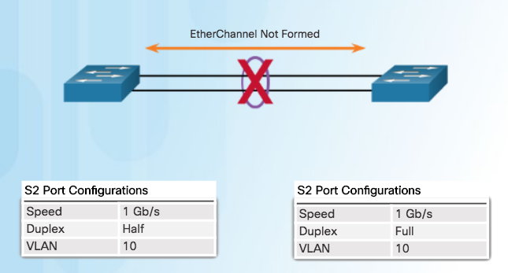
Configuring EtherChannel
Configuration Guidelines (Cont.)
If Configuration Settings Do Not Match
EtherChannel not formed between S1 and S2
Note: When changing settings, configure them in port channel interface configuration mode. The configuration applied to the port channel interface also affects the individual interfaces.
Notes:
4.2 – Link Aggregation Configuration
4.2.1 – Configuring EtherChannel
4.2.1.1 – Configuration Guidelines

Slide 9
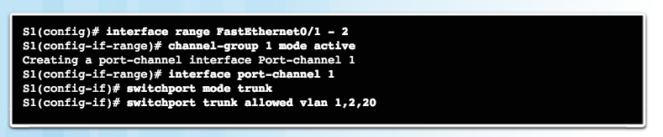
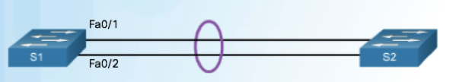
Configuring EtherChannel
Configuring Interfaces
This configuration creates EtherChannel with LACP and configures trunking.
  Step 1: Specify the interfaces that compose the EtherChannel group.
  Step 2: Create the port channel interface with the channel-group command in active mode. (Channel group number needs to be selected.)
  Step 3: Change Layer 2 settings in port channel interface configuration mode.
Notes:
4.2 – Link Aggregation Configuration
4.2.1 – Configuring EtherChannel
4.2.1.2 – Configuring Interfaces

Slide 10
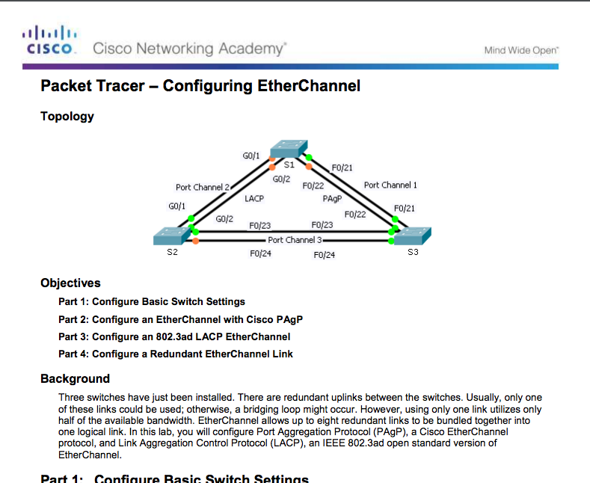
Configuring EtherChannel
Packet Tracer – Configuring EtherChannel
Notes:
4.2 – Link Aggregation Configuration
4.2.1 – Configuring EtherChannel
4.2.1.3 – Configuring EtherChannel

Slide 11
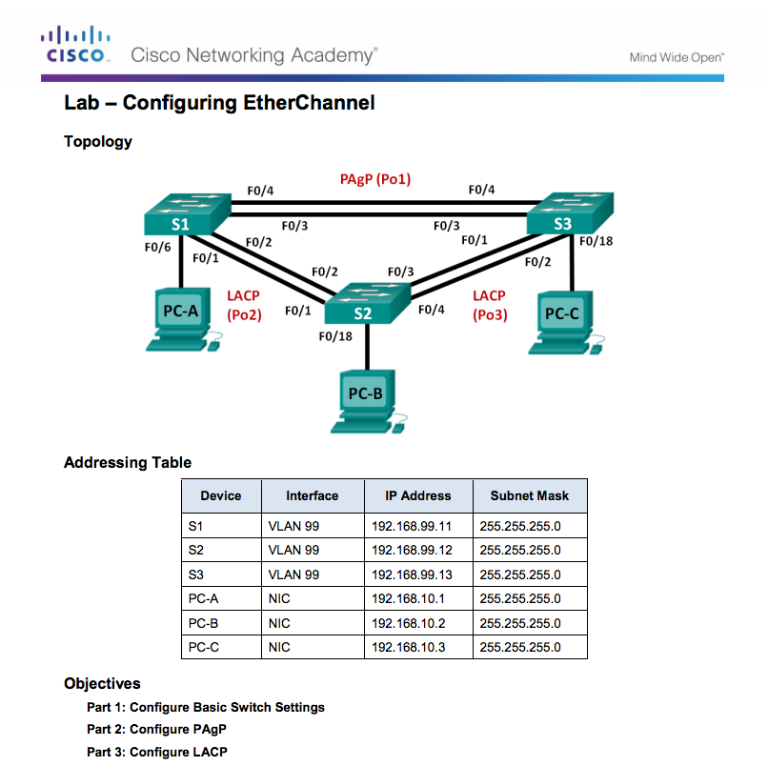
Configuring EtherChannel
Lab – Configuring EtherChannel
Notes:
4.2 – Link Aggregation Configuration
4.2.1 – Configuring EtherChannel
4.2.1.4 – Configuring EtherChannel

Slide 12
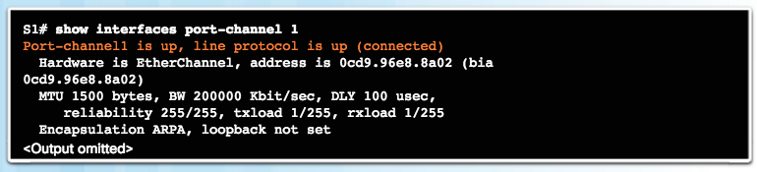
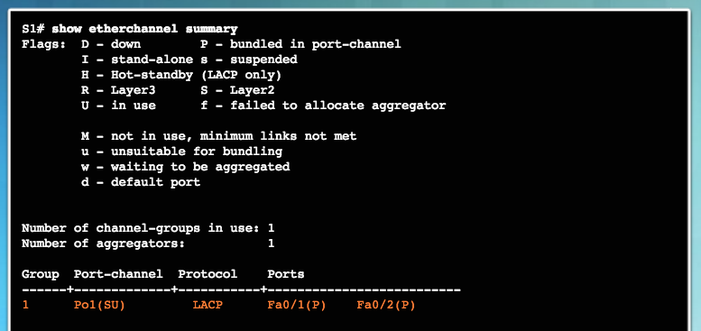
Verifying and Troubleshooting EtherChannel
Verifying EtherChannel
Verifies the interface status.
Displays a one-line summary per channel group.
SU indicates in use.
Notes:
4.2 – Link Aggregation Configuration
4.2.2 – Verifying and Troubleshooting EtherChannel
4.2.2.1 – Verifying EtherChannel

Slide 13
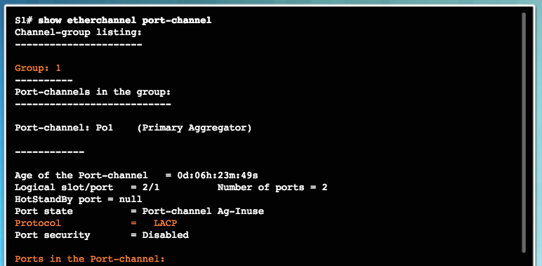
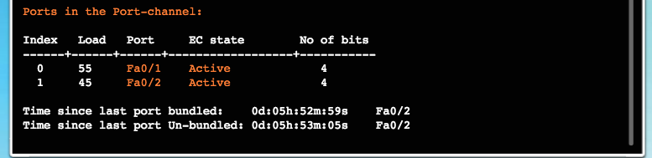
Verifying and Troubleshooting EtherChannel
Verifying EtherChannel (Cont.)
Displays port channel information.
Notes:
4.2 – Link Aggregation Configuration
4.2.2 – Verifying and Troubleshooting EtherChannel
4.2.2.1 – Verifying EtherChannel

Slide 14
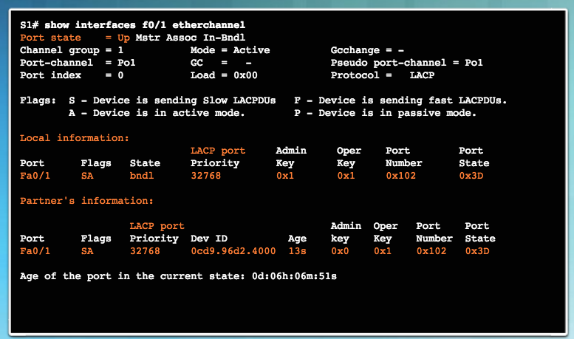
Verifying and Troubleshooting EtherChannel
Verifying EtherChannel (Cont.)
Displays role of particular interface in an EtherChannel.
Notes:
4.2 – Link Aggregation Configuration
4.2.2 – Verifying and Troubleshooting EtherChannel
4.2.2.1 – Verifying EtherChannel

Slide 15
Verifying and Troubleshooting EtherChannel
Troubleshooting EtherChannel
All interfaces within EtherChannel must have the same:
  speed
  duplex mode
  native and allowed VLANs on trunk (Ports with different native VLANs cannot form an EtherChannel.)
  assigned to same VLAN
Notes:
4.2 – Link Aggregation Configuration
4.2.2 – Verifying and Troubleshooting EtherChannel
4.2.2.2 – Troubleshooting EtherChannel

Slide 16
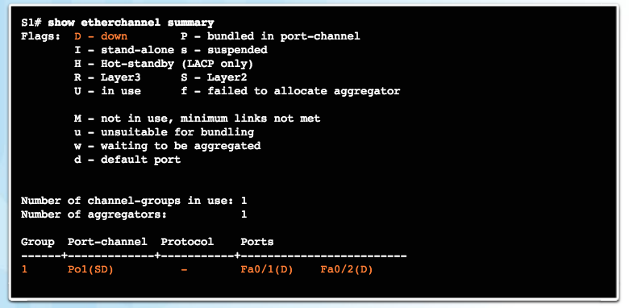
Verifying and Troubleshooting EtherChannel
Troubleshooting EtherChannel (Cont.)
Output indicates that the EtherChannel is down (SD).
Notes:
4.2 – Link Aggregation Configuration
4.2.2 – Verifying and Troubleshooting EtherChannel
4.2.2.2 – Troubleshooting EtherChannel

Slide 17
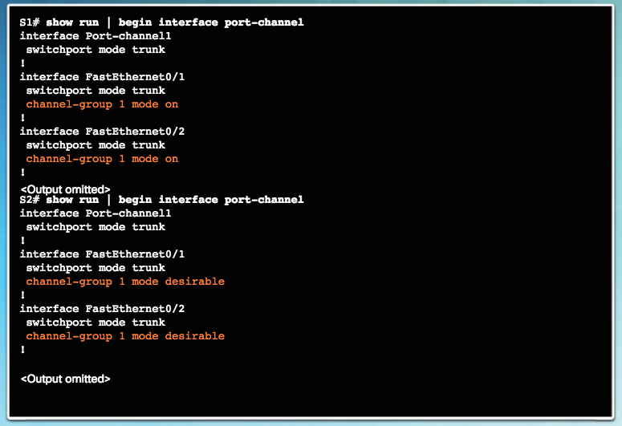
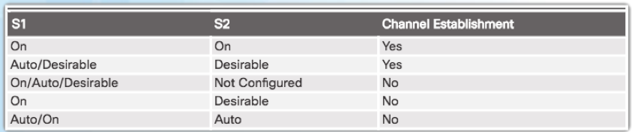
Verifying and Troubleshooting EtherChannel
Troubleshooting EtherChannel (Cont.)
Incompatible PAgP modes configured on S1 and S2.
Notes:
4.2 – Link Aggregation Configuration
4.2.2 – Verifying and Troubleshooting EtherChannel
4.2.2.2 – Troubleshooting EtherChannel

Slide 18
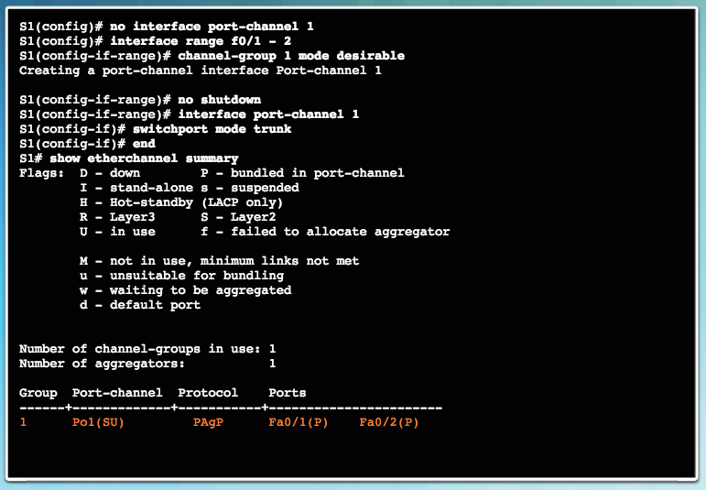
Verifying and Troubleshooting EtherChannel
Troubleshooting EtherChannel (Cont.)
PAgP mode on the EtherChannel is changed to desirable and the EtherChannel becomes active.
Notes:
4.2 – Link Aggregation Configuration
4.2.2 – Verifying and Troubleshooting EtherChannel
4.2.2.2 – Troubleshooting EtherChannel

Slide 19
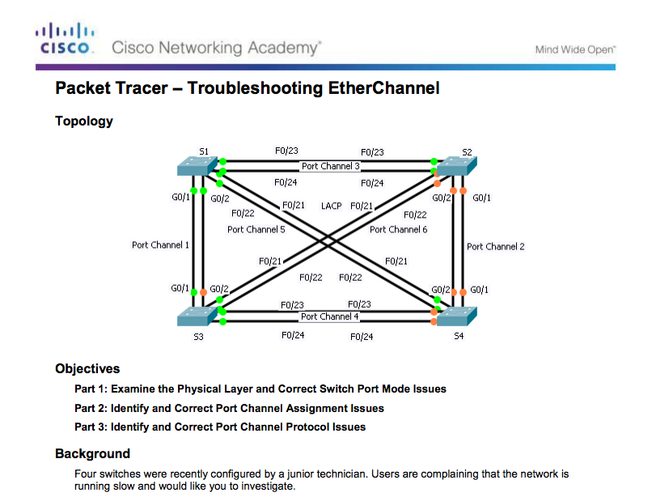
Verifying and Troubleshooting EtherChannel
Packet Tracer – Troubleshooting EtherChannel
Notes:
4.2 – Link Aggregation Configuration
4.2.2 – Verifying and Troubleshooting EtherChannel
4.2.2.3 – Packet Tracer - Troubleshooting EtherChannel

Slide 20
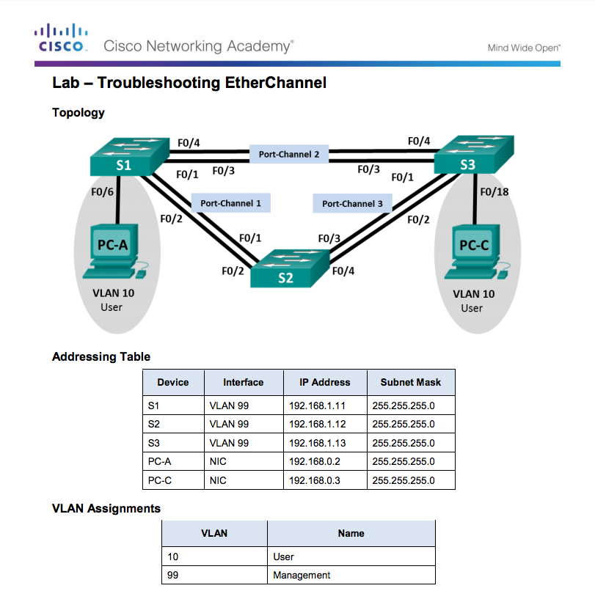
Verifying and Troubleshooting EtherChannel
Lab – Troubleshooting EtherChannel
Notes:
4.2 – Link Aggregation Configuration
4.2.2 – Verifying and Troubleshooting EtherChannel
4.2.2.4 – Lab- Troubleshooting EtherChannel

